Slide 1




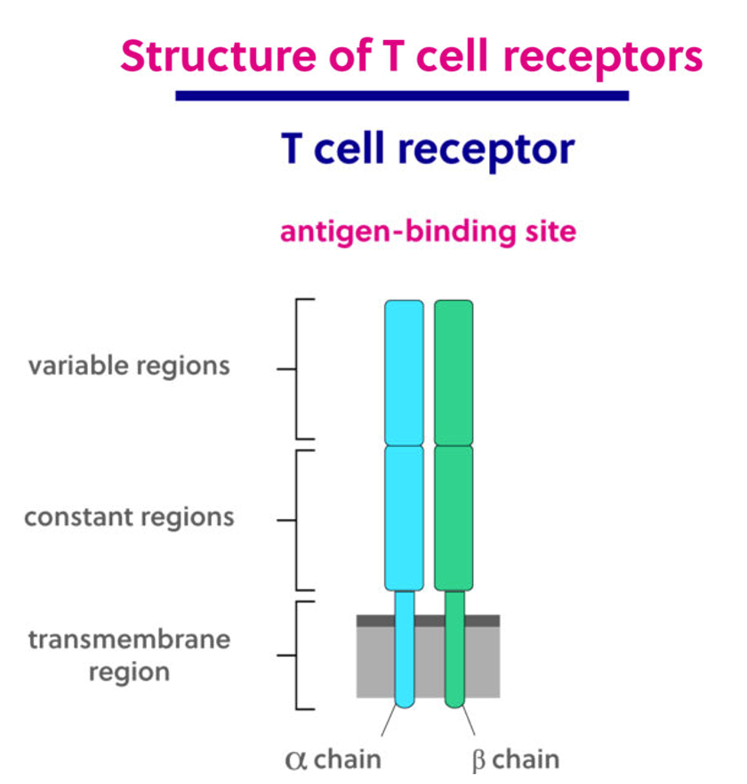
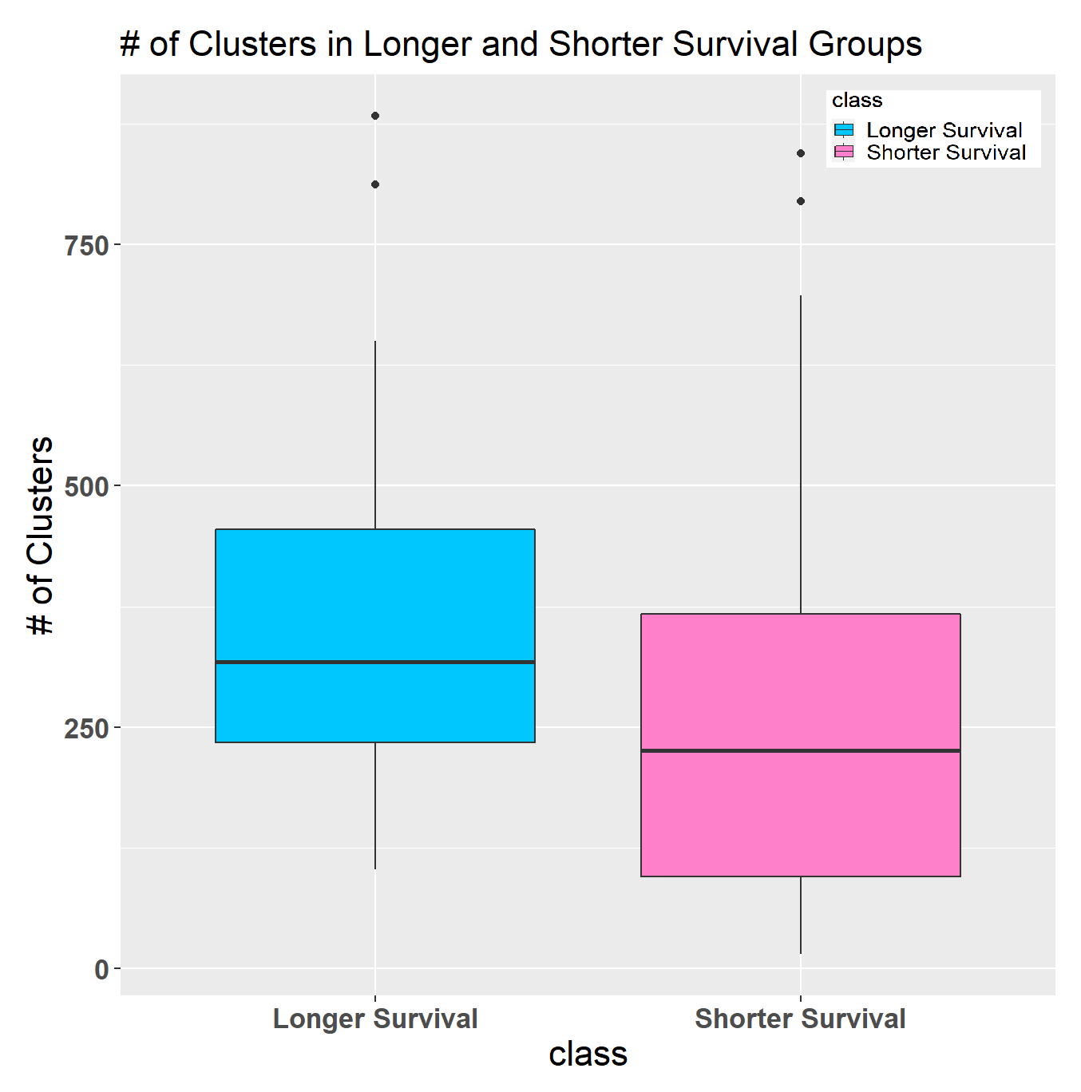
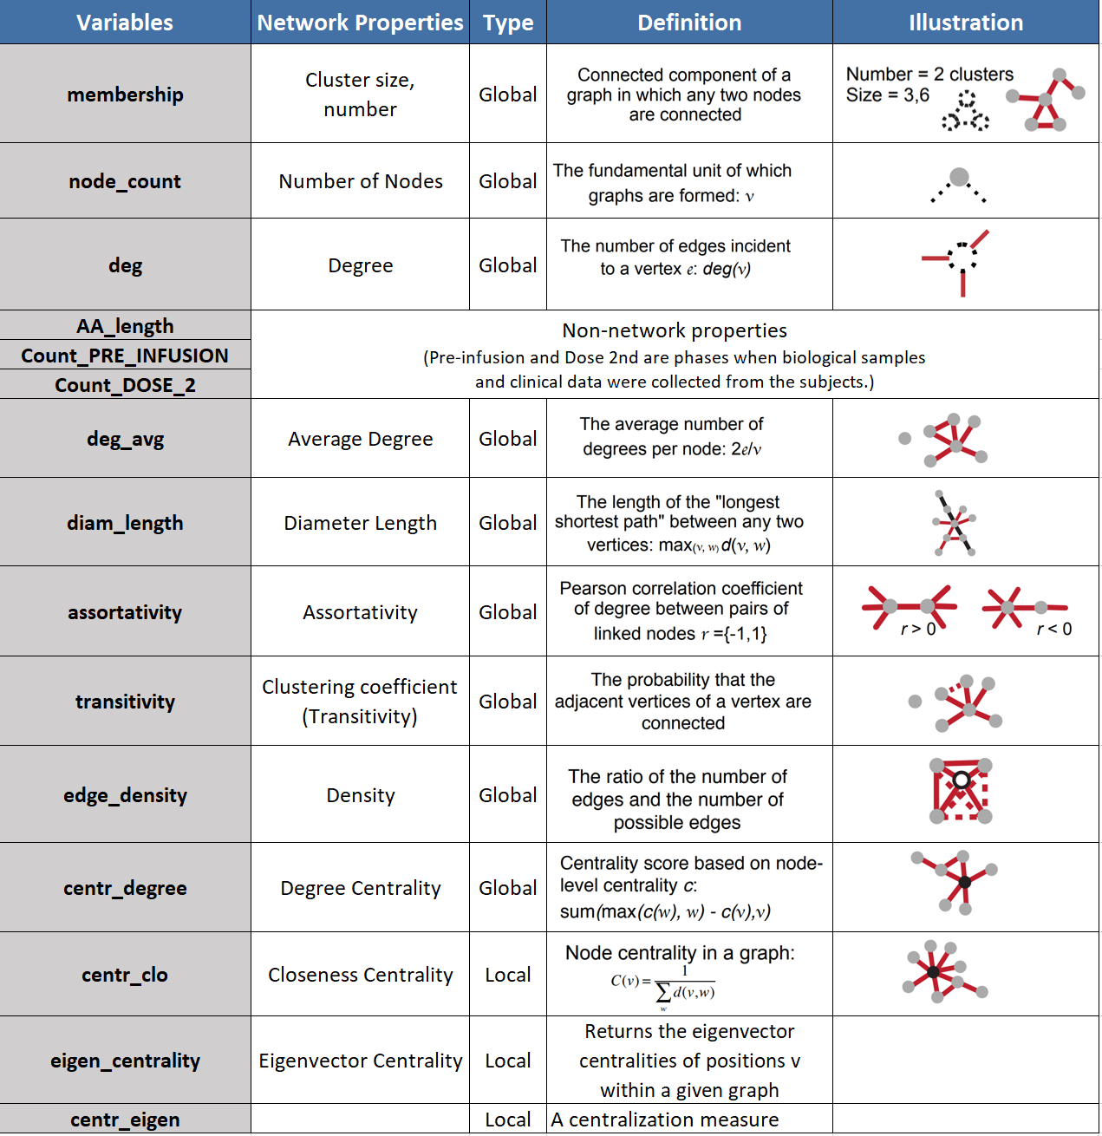
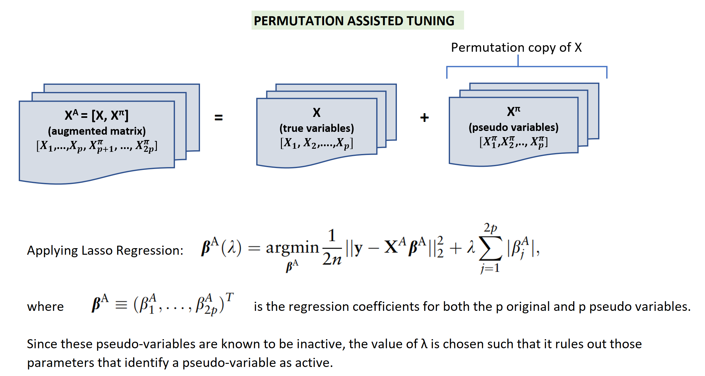
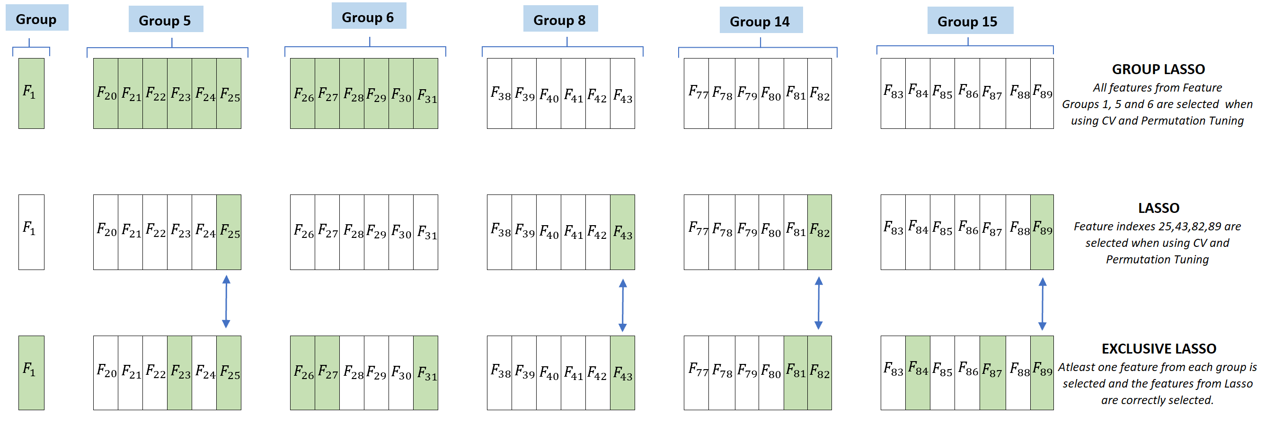

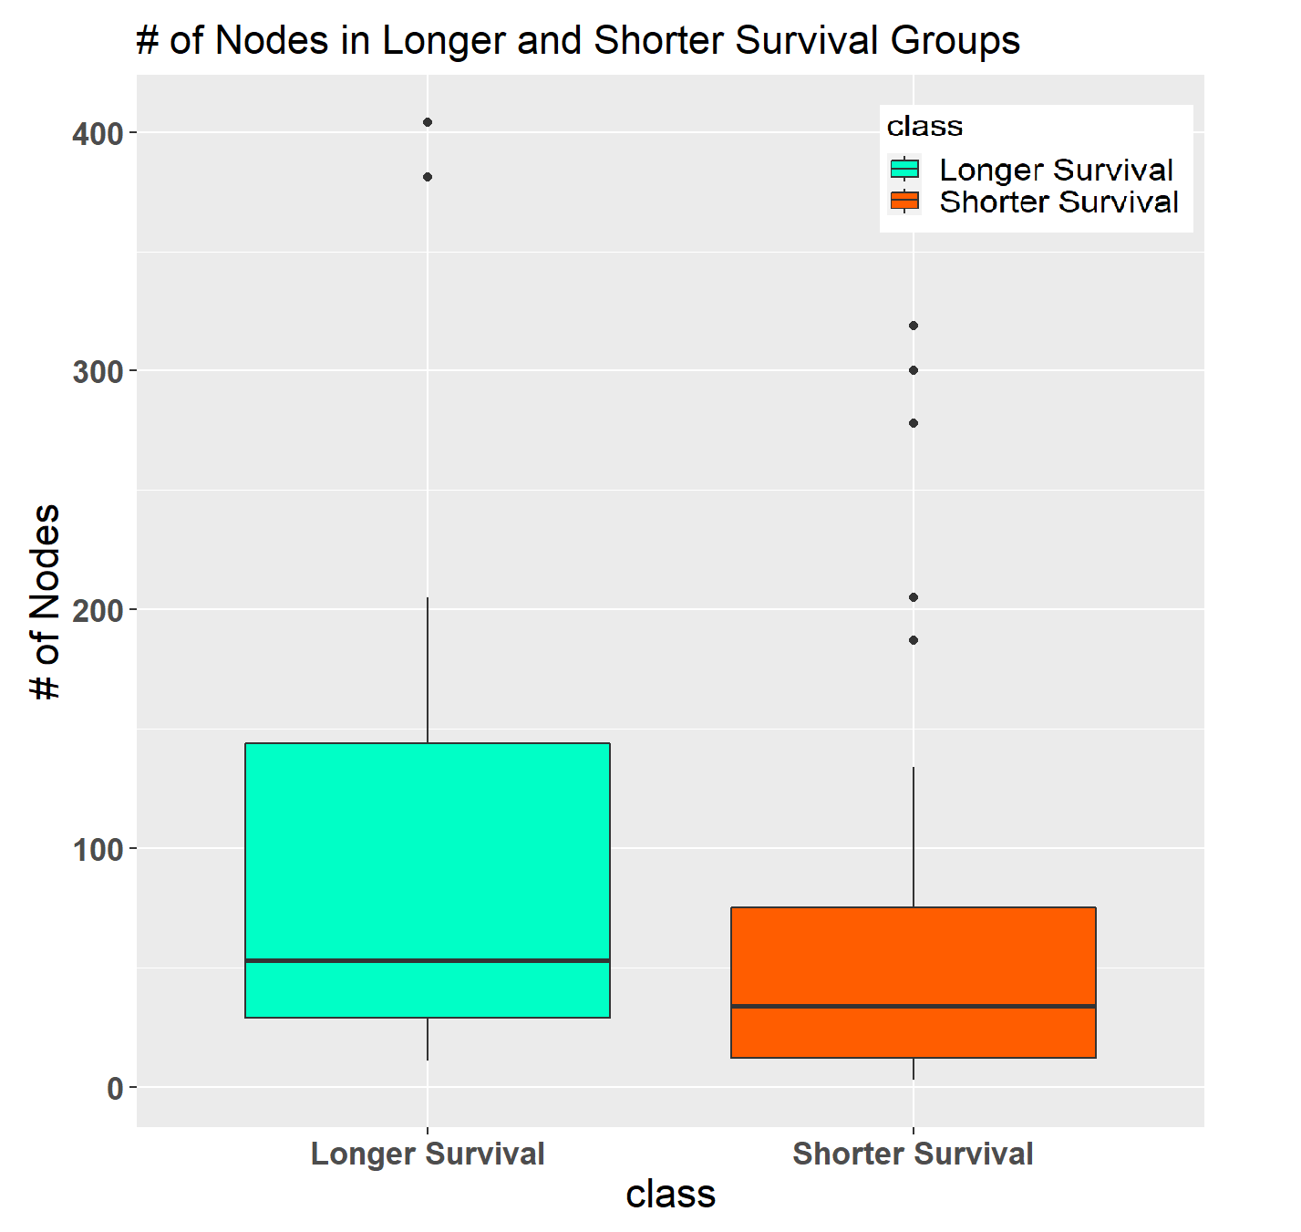
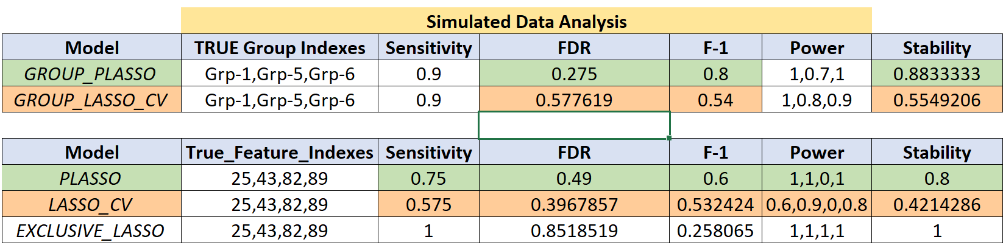
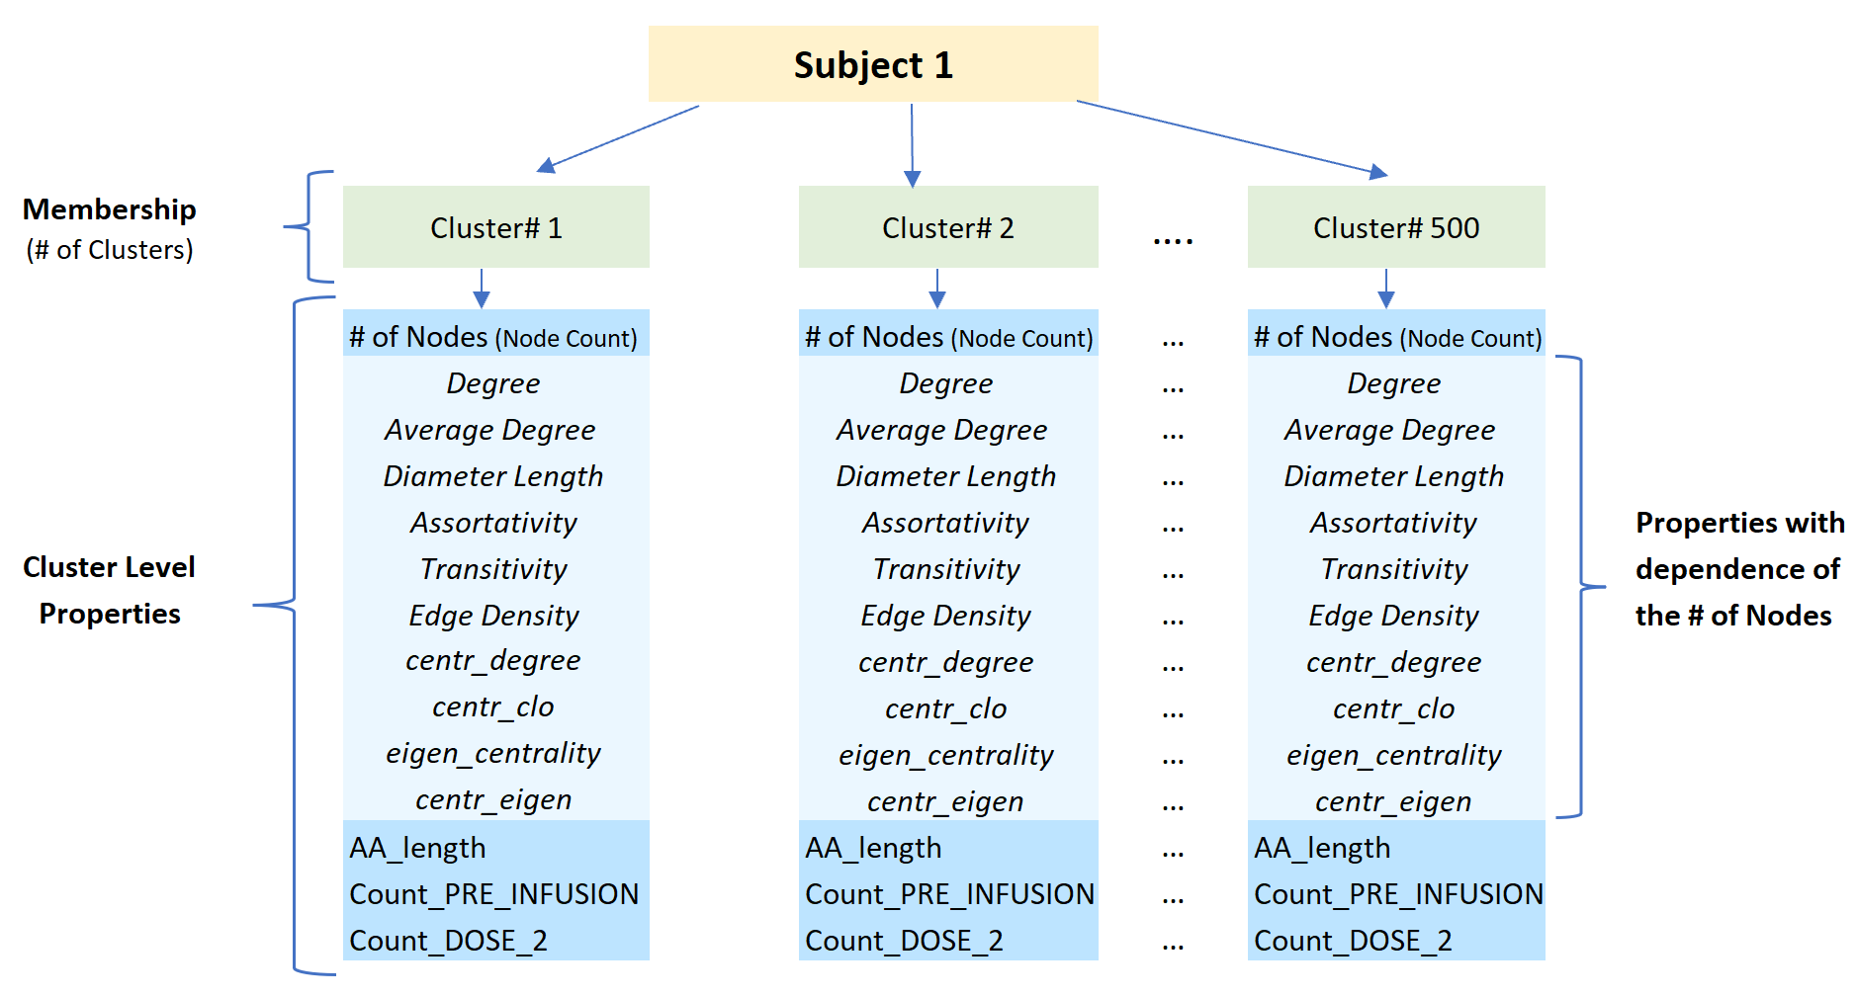
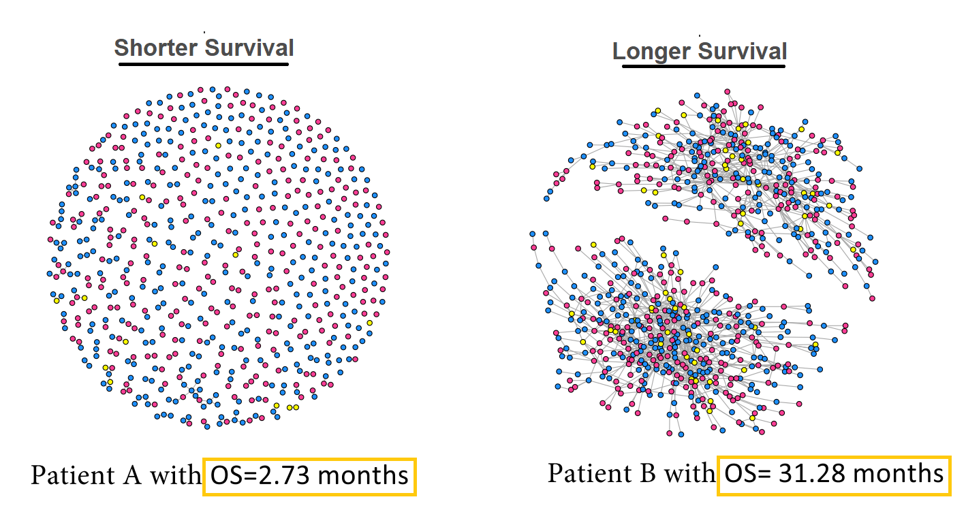
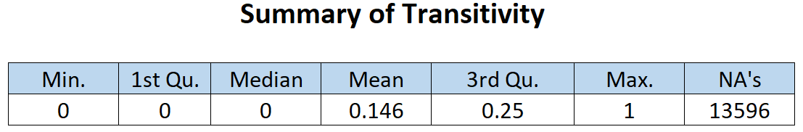
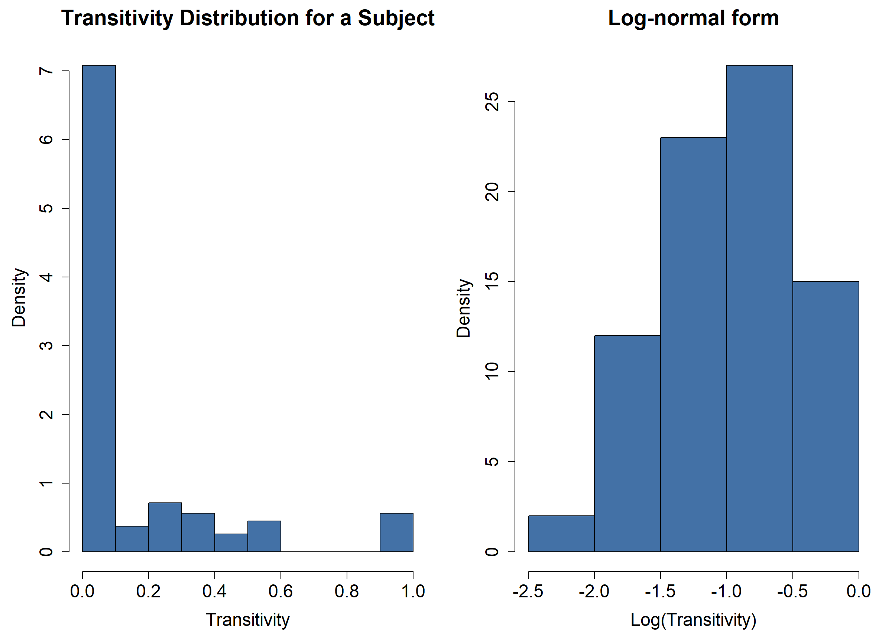
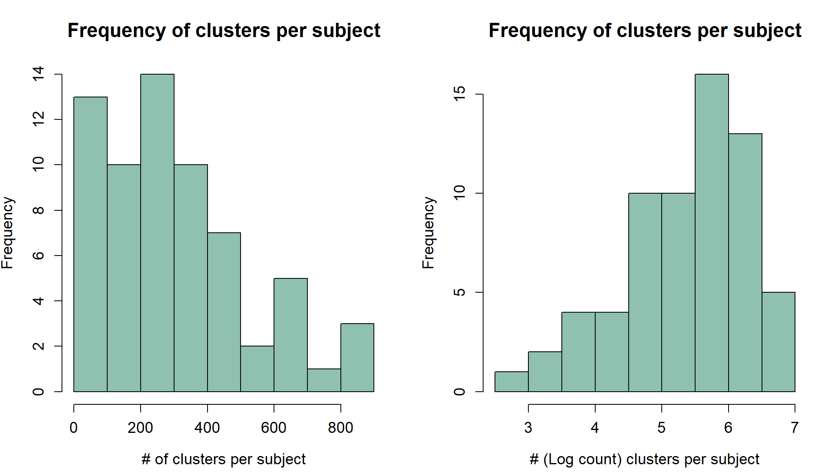
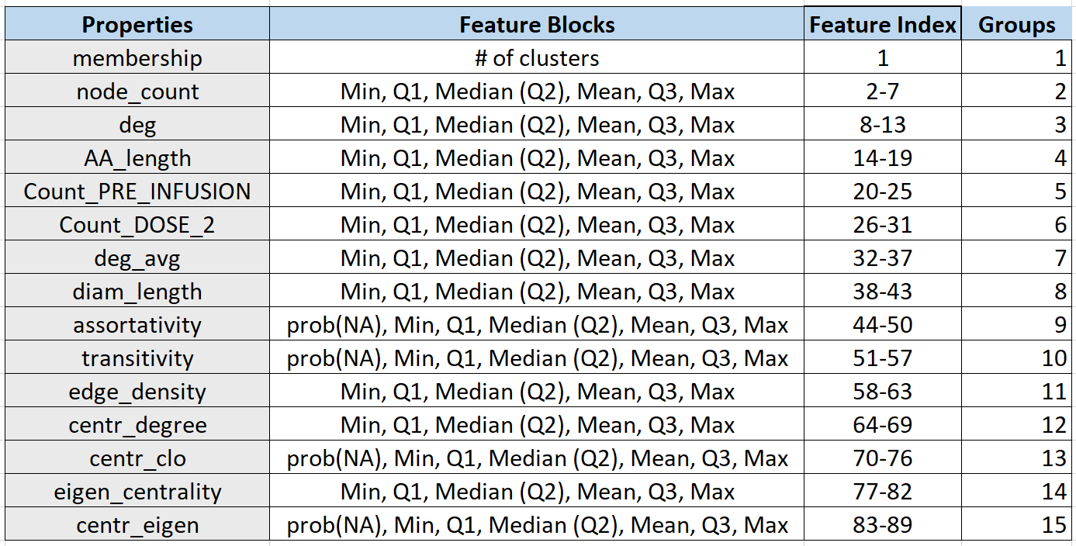
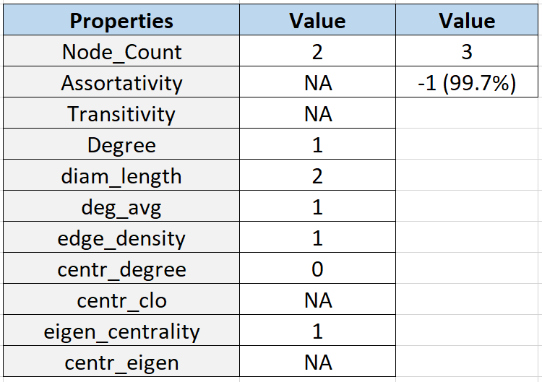
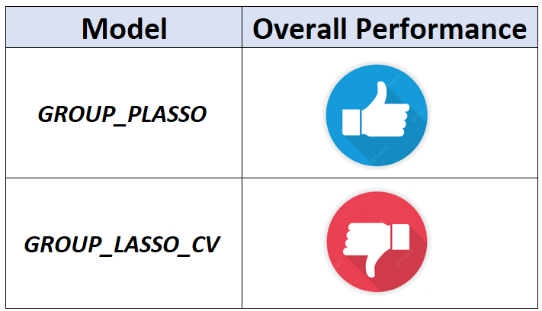
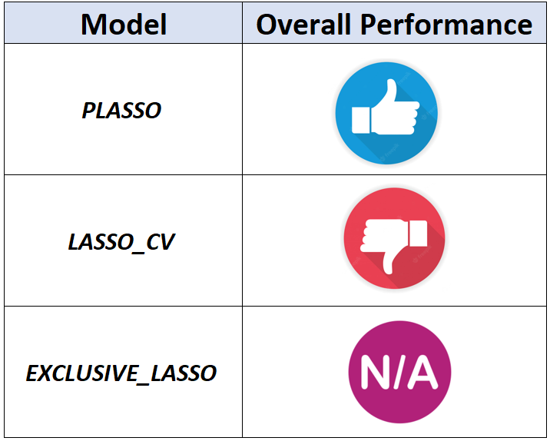
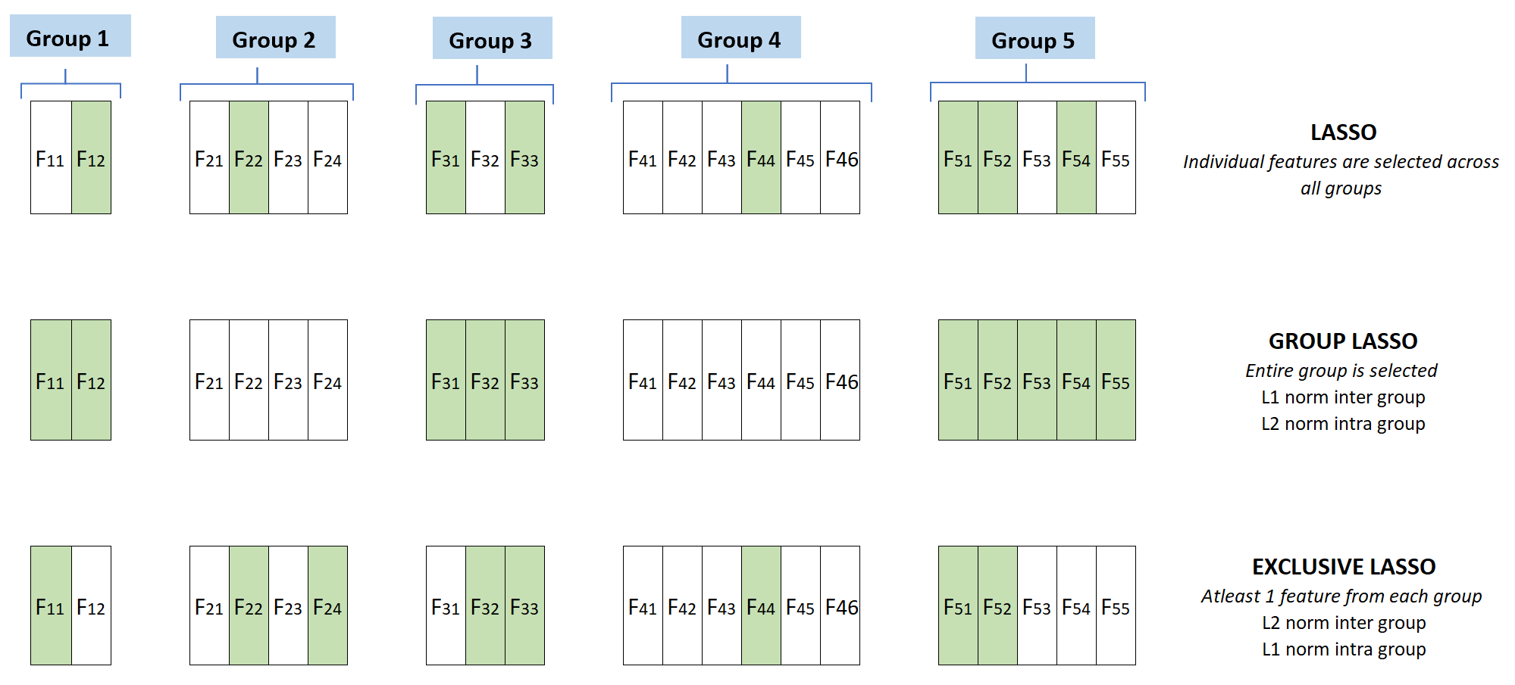
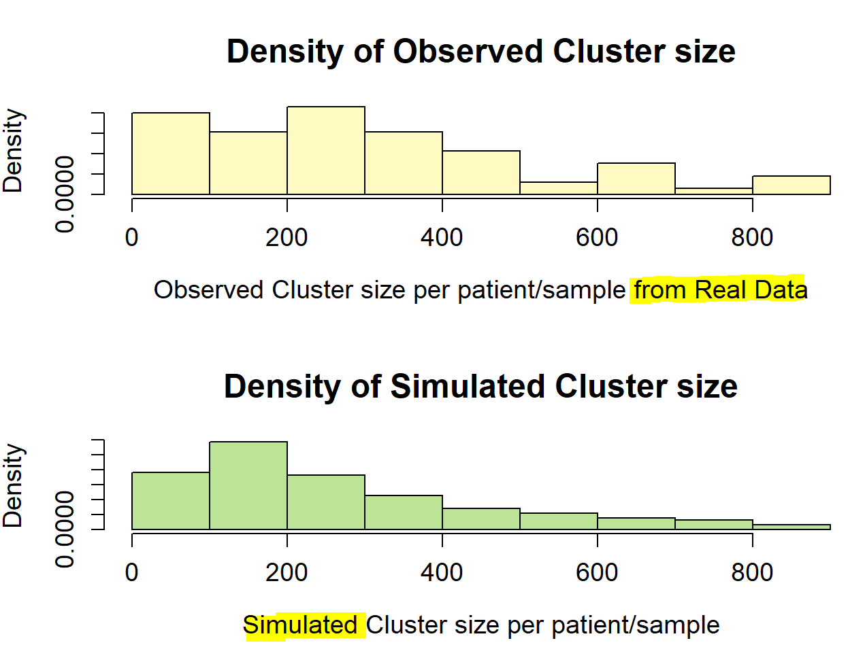
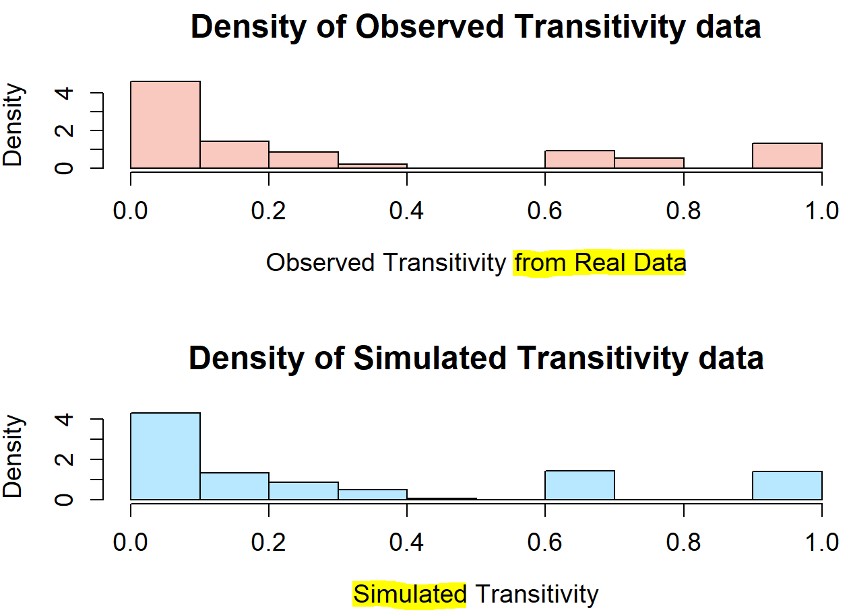

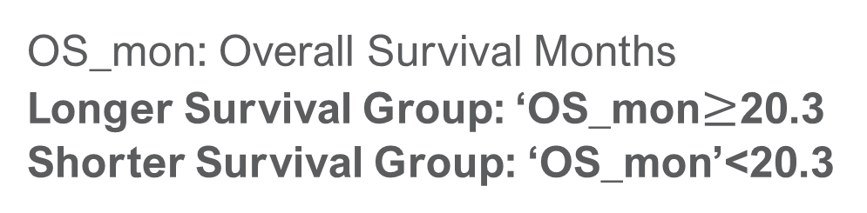
PRIORITIZING NETWORK PROPERTIES OF TCR REPERTOIRE A Novel Approach To Select Network Signatures From TCR Repertoire Data
Shilpika Banerjee¹ Tao He¹ Li Zhang²
¹Department of Mathematics, San Francisco State University; ²Department of Medicine, University of California San Francisco
Introduction
TCR repertoire properties
Prioritizing network properties: GROUP LASSO with permutation tuning
Results
Background
Group lasso is used to identify the active groups of properties and the permutation assisted tuning helps to reduce potential false positives of variable selection by using pseudo-variables.
Real Data Analysis
T cells are crucial components of the adaptive immune system, mediating anti-tumoral immunity and immune response to infections.
T cell receptor (TCR), which is a protein complex on T-cell surface, targets specific antigens based on nucleotide sequence.
LASSO (with Cross Validation), PLASSO (LASSO with permutation tuning), Group PLASSO, Group LASSO (with Cross Validation), and Exclusive LASSO (with Cross Validation) feature selection techniques were run on the real data.
Figure 3
Figure 6
Selecting top network features using PLASSO and Exclusive LASSO
Figure 11
Figure 2
Lasso regression with permutation assisted tuning (PLASSO) is used to select the top TCR network features across all groups. PLASSO is indifferent to the group structure created for the network properties.
Exclusive lasso with cross validation on the other hand selects the top features from each TCR network property groups.
Simulation Study
Figure 1
TCR repertoires continually shaped throughout the lifetime of an individual in response to pathogenic exposure and can serve as a fingerprint of an individual’s current immunological profile.
The similarity among TCRs sequence directly influences the antigen recognition breadth. Network analysis, which allows interrogation of sequence similarity, thereby adds an important layer of information. To construct a clonal network, each clone is defined as a node, and then based on the sequence distance, an edge is drawn based on a certain similarity condition (e.g., one letter difference in sequence).
Simulation studies were performed for comparing the different feature selection techniques and to assess their performances.
Figure 4
Table 1
(Fig-3, 4 show longer survival subjects have more # of clusters and nodes compared to the shorter survival subjects.)
Proposed simulation scheme
Methods
Figure 12
Motivation & Objective
Aggregating Heterogenous Network Data
The objective is to investigate the network properties and develop novel statistical method to prioritize the important network properties that are associated with the clinical outcome.
Network analysis allows interrogation of sequence similarity.
TCR network repertoire vary in structure and sizes across different subjects and are continually shaping. Therefore, summary statistics are extracted from the properties and are grouped as blocks. Objective is to study which features are significant and which feature blocks (n/w properties) as a group are significant.
Figure 13
Conclusion
Real Data Analysis:
Group Lasso renders feature blocks ‘Membership (# of Clusters)’, ‘Count_PRE_INFUSION’, and ‘Count_DOSE_2’ as significant groups.
Lasso and Exclusive Lasso render features ‘Count_PRE_INFUSION_Max’, ‘diam_length_Max’, ‘eigen_centrality_max’, ‘centr_eigen_max’ as significant.
Simulation Study:
Group Lasso on simulated data has better performance when using the ‘True Group Indexes’ from Group Lasso run on real data.
Permutation assisted tuning has better performance measures than that of cross-validation.
From the above study we can conclude that for Feature Selection, permutation assisted tuning performs better than cross-validation.
Figure 3
OS_mon: Overall Survival Months
Longer Survival Group: ‘OS_mon$≥$20.3
Shorter Survival Group: ‘OS_mon’<20.3
(Fig-3 show the networks of two lung cancer patients' TCR repertoire. There is some evidence that the two groups (shorter & longer survival) have different network structures)
For a single subject, the Transitivity n/w property has several NA’s and the numerical values have roughly a log-normal form.
The following summary statistics are derived for Transitivity and considered as a single block/group for feature extraction:
prob(NA), Min, Q1, Median, Mean, Q3, Max
Similarly, based on the values of the TCR network properties, relevant summary statistics are derived for each property and distinct groups are created for them.
Based on the distribution of the # of clusters per subject, the data for ‘Membership’ is generated for 1000 dummy subjects and is later down sampled.
Using histogram plots for the remaining properties a rough estimation of their distribution is made. Leveraging the simulated Cluster count, and evaluating their dependencies on the # of Nodes, the remaining network properties are simulated.
Figure 7
Challenges
Figure 5
Heterogeneous nature of the TCR repertoire and network properties makes it extremely difficult to perform statistical inference or machine learning directly between subjects.
Less than 20% overlaps across repertoire, even for the same subject.
Each network has different total number of clusters, total number of nodes.
Network properties have difference representations: some of them are global (described by one number) and some of them are local (described by a vector of values, and vector length varies).
Figure 14
(Feature Group selection)
Figure 15
Table 2
Table 3
Figure 8
(Feature Selection)
Our Contribution
(Tbl-3 represents the correlation of the other network properties on ‘Node_Count’ values.)
Reference
In this paper, we proposed a novel method to prioritize the network properties that are associated with the outcome of interest, based on features extracted from heterogeneous global/local network properties. We also proposed schemes to select the top features associated and simulated the network properties using the real data.
The sample dataset comprises 65 distinct subjects and their respective TCR repertoire information. Since the true causal variables are unknown, merely applying feature selection techniques on the real sample data will not be adequate. Simulation studies would be required to assess the various models.
One major challenge here is to simulate the heterogenous nature of the TCR data. In this paper we have chosen to study the distributions of the various network properties of TCR data and any significant correlations.
Models Used for Prioritizing and Selecting Network Properties
https://doi.org/10.1038/s41467-019-09278-8
Acknowledgement
Figure 9
Figure 10
Figure 6
(Fig-9,10 are used to show the Density plots for the real (observed) data and the simulated data for two of the TCR repertoire properties.)

